Slide 1
The Service Transition

Slide 2
Service Transition Overview
Goal
The goal of the Service Transition Lifecycle is is to assist organizations seeking to plan and manage service changes and deploy service releases into the production environment successfully.
The goals of Service Transition are to:
Set customer expectations on how the performance and use of the new or changed service can be used to enable business change;
Enable the business change project or customer to integrate a release into their business processes and services;
Reduce variations in the predicted and actual performance of the transitioned services;
Reduce the known errors and minimize the risks from transitioning the new or changed services into production;
Ensure that the service can be used in accordance with the requirements and constraints specified within the service requirements.

Slide 3
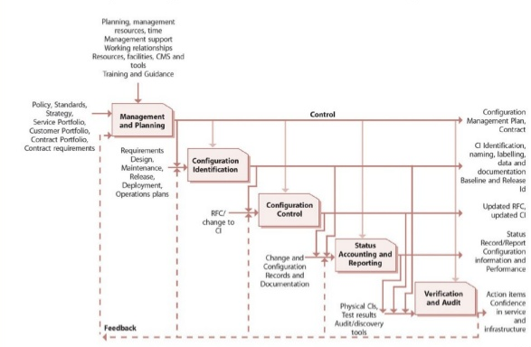
Service Transition Flow

Slide 4
Service Transition Processes
There are seven processes covered under Service Transition:
Transition Planning & Support;
Change Management;
Service, Asset & Configuration Management;
Release & Deployment Management;
Service Validation and Testing;
Evaluation;
Knowledge Management.

Slide 5
1) Transition Planning & Support
Plan appropriate capacity resources to package, build, release, test, deploy and establish a new or changed service to production within predicted: cost, quality and estimated time.
Ensure that transition issues, risks and deviations are reported to the appropriate stakeholder and decision maker.

Slide 6
2) Change Management
Goals:
Ensure Standardized methods and procedures;
Reduce Incidents, disruptions and rework;
Align business needs and technical demands;
Overall risk is optimized;

Slide 7
Change types:
Standard: A change to a service or infrastructure that has an accepted and established procedure to provide a specific change requirement for which the approach is pre-authorized by Change Management;
Normal: Unless a change falls into one of the other models, it is considered a normal change. Most organizations will have more than more than one type of normal change. (e.g. major, minor, etc.);
Emergency: A change intended to repair an error in an IT service that is negatively impacting the business to a higher degree.

Slide 8
Change Roles
Change Advisory Board
- Supports the change manager
- Consulted on major and significant changes
Emergency CAB (ECAB)
- Subset of standard CAB
- Membership depends on the specific change

Slide 9
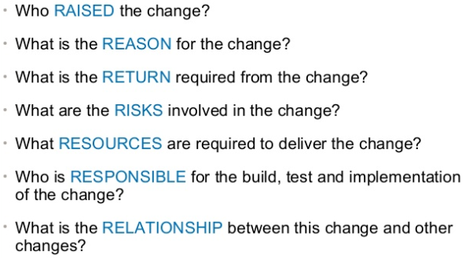
7 Rs of Change Mangement

Slide 10
Change Process
Inputs | Outputs
Change Policy and Stategy; RFCs; Change Proposals; Service Management Plans; Assets and Configuration Items; Existing Change Management Documents: Change schedule; Projected service outage (PSO); | Rejected and approved RFCs; Changes to services and Cis; Updated: Change schedule; PSO; Change Plan, Decision, Actions; Change documents and records; Management reports.

Slide 11
Change Key Performance Indicators
Compliance
Reduction in unauthorized changes;
Reduction in emergency changes;
Effectiveness
Percentage of changes which met requirements;
Reduction in disruptions, defects and rework;
Reduction in changes failed/ backed out;
Number of incidents attributable to changes;
Efficiency
Benefits (value compared to costs);
Average time to implement (by urgency/priority/type);
Percentage accuracy in change estimates.

Slide 12
3) Service, Asset & Configuration Management (SACM)
Definitive Media Library (DML)
It is the secure library in which the definitive authorized versions of all media CIs are stored and protected.
It stores master copies of versions that have passed quality assurance checks. This library may in reality consist of one or more software libraries or file storage areas, separate from development, test or live file-store areas.
It contains the master copies of all controlled software in an organization. The DML should include definitive copies of purchased software (along with license documents or information), as well as software developed on site.
Master copies of controlled documentation for a system are also stored in the DML in electronic form.
Definitive spares
An area should be set aside for the secure storage of definitive hardware spares. These are spare components and assemblies that are maintained at the same level as the comparative systems within the controlled test or live environment.

Slide 13
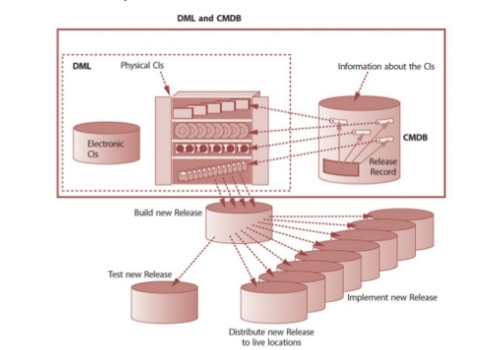
Relationship: DML and CMDB

Slide 14
4) Release & Deployment Management
Release design options:
It is important to understand the patterns of business activity (PBA) and user profiles when planning and designing the releases.
‘Big bang’ option – the new or changed service is deployed to all user areas in one operation. This will often be used when introducing an application change and consistency of service across the organization is considered important.
Phased approach – the service is deployed to a part of the user base initially, and then this operation is repeated for subsequent parts of the user base via a scheduled rollout plan. This will be the case in many scenarios such as in retail organizations for new services being introduced into the stores’ environment in manageable phases.
Push and pull - A push approach is used where the service component is deployed from the center and pushed out to the target locations. A pull approach is used for software releases where the software is made available in a central location but users are free to pull the software down to their own location at a time of their choosing or when a user workstation restarts.

Slide 15
Releases: Automated vs Manual
Automation will help ensure repeatability and consistency. However it may not be possible to provide a well designed and efficient automated mechanism due to time constraints.
If a manual mechanism is used, it is important to monitor and measure the impact of many repeated manual activities as they are likely to be inefficient and error prone.
Many of the Release and deployment activities are capable of a certain degree of automation.

Slide 16
5) Service Validation and Testing
Quality assure a release, its constituent service componentes and the resultant service and capability;
Identify, assess and address issues, erros and risks thoughtout Service Transition;
Provide confidence and validate the service “fit for purpose” and “fit for use” = meet the specifications;
Remedy any errors or variances early in the service cycle as this considerable cheaper than fixing in production.

Slide 17
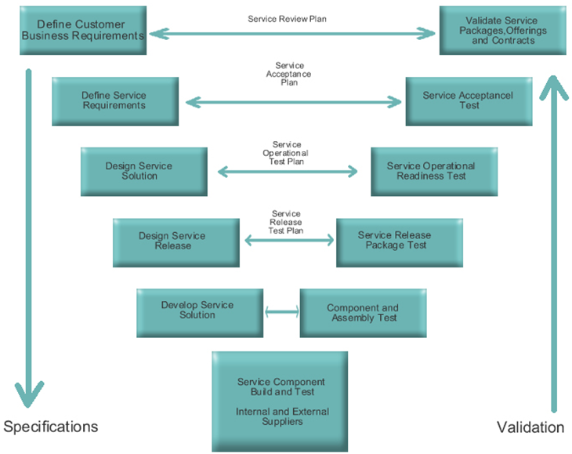
Service ‘V’ Model

Slide 18
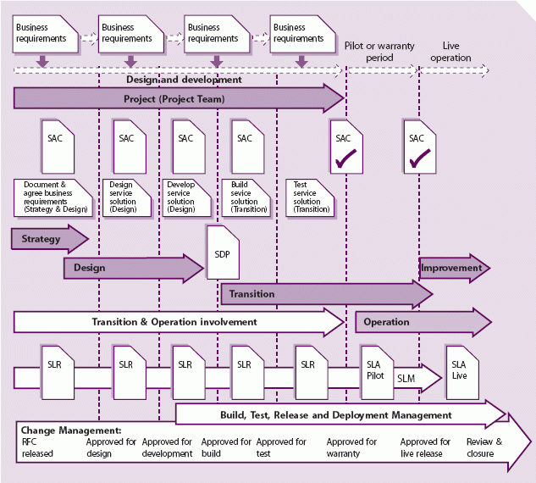
Exit Criteria

Slide 19
6) Evaluation
Ensure the service cover the standard determinated by the customer;
Ensure the service cover the Market standards;
Documentation was properly produced, stored and share between all involved teams.

Slide 20
7) Knowledge Management
To ensure the right information is delivered to the appropriate place or competente person at the right time to enable decisions;
To enable organization to improve quality thoughout the service lifecycle;
Enable the service provider to the more efficient and improve quality of service.

Slide 21
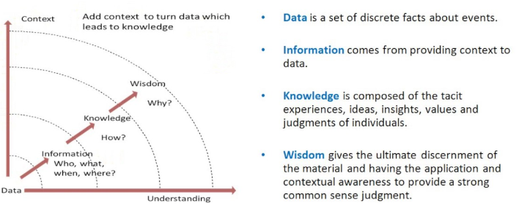
DIKW concept

Slide 22
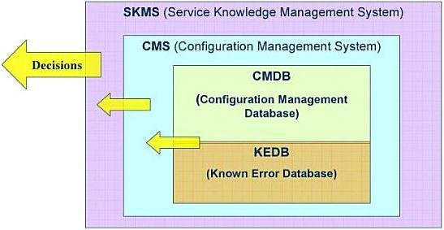
Relationship: SKMS, CMS, CMDB and KEBD

Slide 23
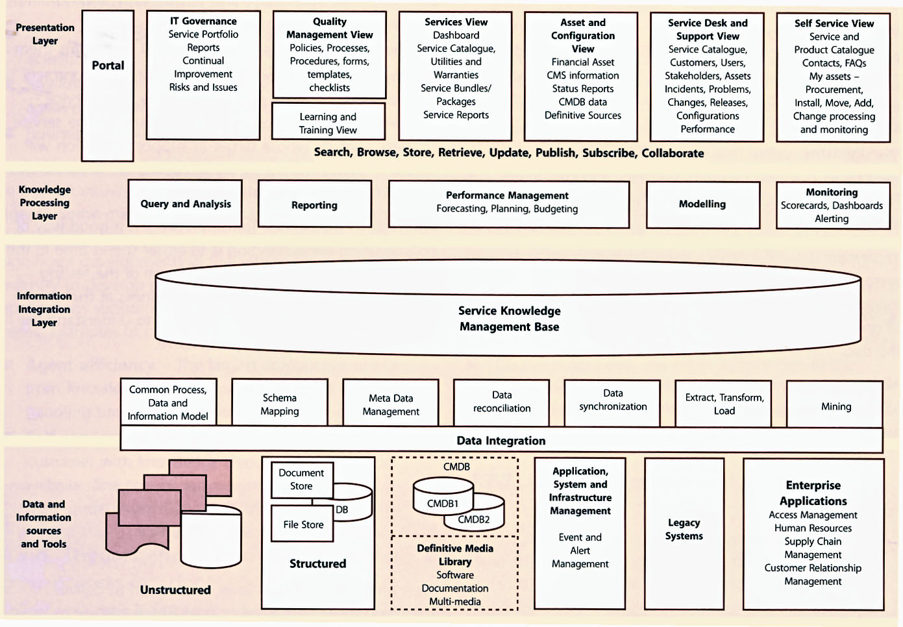
Service Knowledge Management System (SKMS)

Slide 24
References
Vanderbilt University IT Service Management Program IT Knowledge Management Strategy
https://www.hci-itil.com/ITIL_v3/images/service_transition_ch4_fig_4_39.jpg
HP Service Transition
https://www.slideshare.net/sagaroceanic11/5-service-transition

